Slide 1
Digital Marketing Audit
Biriyani Box
http://biriyanibox.com/
18 - 05 - 2021

Slide 2
Website Audit
UX Insights
It is a Single Page Application.
There are 5 order now buttons in a single page.
On clicking the order now button the web-page is redirected into another website (https://ristaapps.com/)
Nothing to interact with other than social media links and order now button.
Responsive on mobile and desktop

Slide 3
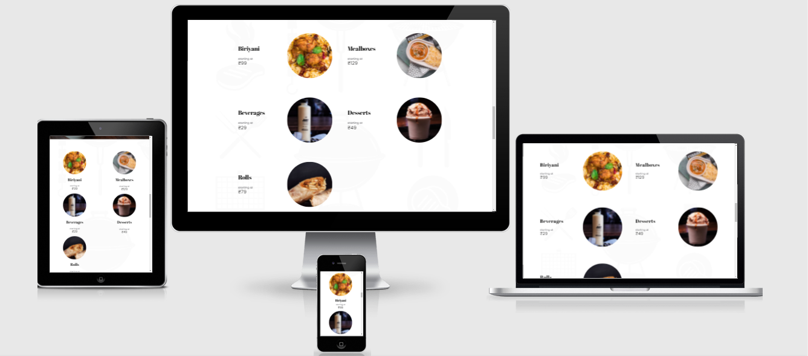
Responsive check:

Slide 4
SEO Audit
Content Insights
Plagiarism - No Plagiarism (Less Content on Website)
Keyword Presence
Local Search results
Searched (biriyani box) and got About 75,700 results (0.73 seconds) // specific
Searched (tasty biryani in odisha) and got 1,90,000 results in 0.72 seconds //generic
Biriyani Box at number 2.
No keyword stuffing + Recommendations(cheap biriyani(high),biryani 1 kg price(medium), best biryani in bhubaneswar(low))
Average monthly search (biriyani box) = 1K – 10K
Title tag of length 28 but no meta tags + keyword usage should be consistent and content should be added
Sitemap : No broken links found
Robots
Alt Texts (Images) : 20 images on the page and 18 of them are missing the attribute.
Backlinks - 82 backlinks

Slide 5
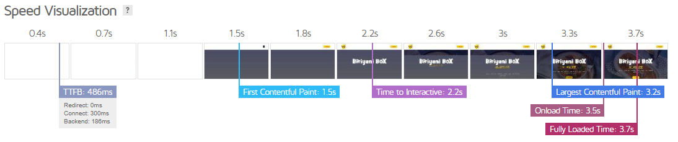
SEO Audit
Website Load Speed Performance
Insert speed test results
FROM GT METRIX:

Slide 6
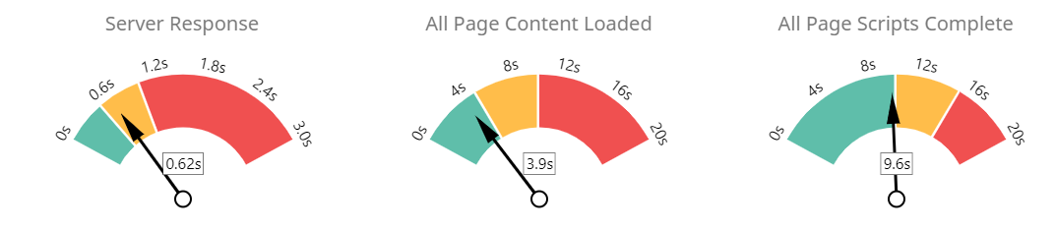
From Seoptimer
SPEED RESPONSE

Slide 7
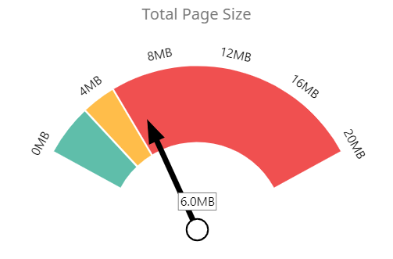
Total Page Size

Slide 8
Key Recommendations
Include a meta description tag
Add ALT attributes to all images
Using main keywords across the important HTML tags
Enable SSL on the website
Increase content ( description of different biriyani’s could do ) with proper keywords.
ADDITIONAL RECOMMENDATION:
If they share various recipes of biriyani people can make at home during lockfown, it may increase their reach.

